Slide 1
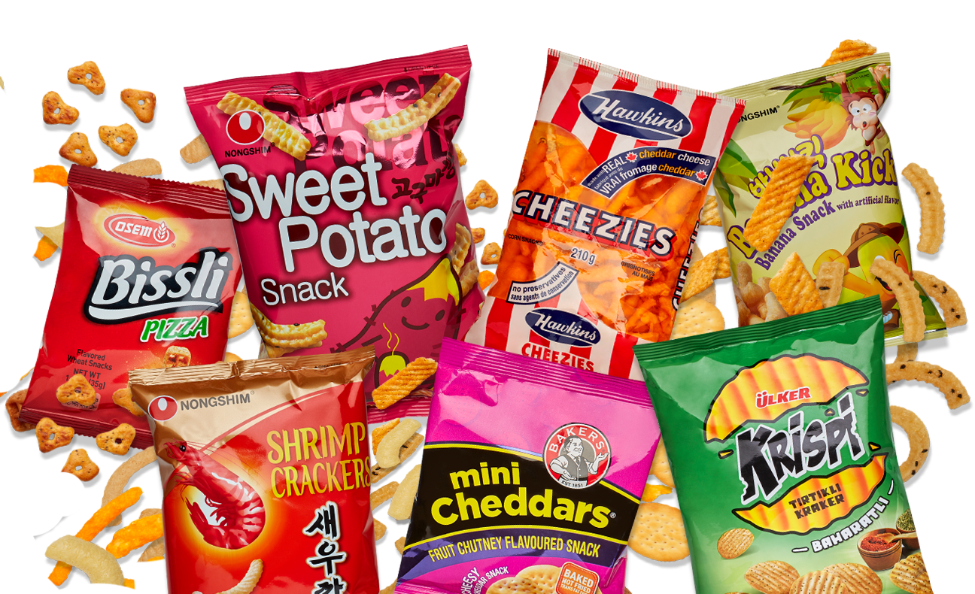
PodKnow:
Project Class Presentation
Harini Booravalli
Christopher Edgecombe
Jeremy Hudson
Jamie Weathers
Kun Vincent Yang
Team Snack Overflow

Slide 2

T1. Description
Main goal:
Collect podcast episodes from popular streaming websites and analyze the textual data within each episode.
Categorize the podcasts based on the content within them instead of predefined genres.
Method:
Using speech to text transcription and topic modeling we analyzed the top 200 podcasts from iTunes.

Slide 3
Task By Member
Jeremy Hudson
Setup Google Speech To Text API
Experimented with different speech to text engines (PocketSphinx and Google Speech to Text API)
Topic modeling using Gensim LDA models
Determined similarity between topics using Hellinger distance
Built LDA models from bigrams and performed statistical analysis on them
Jamie Weathers
Developed a program using Google Speech to Text API to transcribe all podcasts at once
Developed a web scraper to download latest episode audio from PodBay.fm
Performed statistical analysis from Transcription Data
Generated a random forest regression from sample podcast data
Kun Yang
Acquired data from Google Speech to Text API
Acquired data from iTunes RSS API to get current top 200 podcasts
Developed an automated audio converter and an automated file uploader to Google Cloud
Performed statistical analysis on Google Speech to Text pricing
Used linear regression to find trending words

Slide 4
Task By Member
Christopher Edgecombe
Acquired data from Google Speech to Text API
Used the Natural Language Toolkit to remove stopwords and generate pickled output files for language processing
Used SciKit and Gensim LDA models to perform topic modeling for the entire corpus
Determined frequency of topic discussion vs content in podcast title
Harini Booravalli
Acquired data from Google Speech to Text API
Data analysis and preprocessing
Used LSA for Topic Modeling
Analyzed statistics for LSA models with single words
Formed a Topic Similarity Matrix from LSA results

Slide 5
Acquiring Data: Questions Posed
How do we acquire the transcripts?
We “Scraped” the audio data from the top 200 Itunes list.
We used student free credit Google bucket accounts to transcribe the data.
Why did we choose these methods?
The cost of acquiring the audio data was free.
The Google Speech to Text API had the highest confidency of translating the data (Word Error Rate of 9%, lowest in industry.)

Slide 6
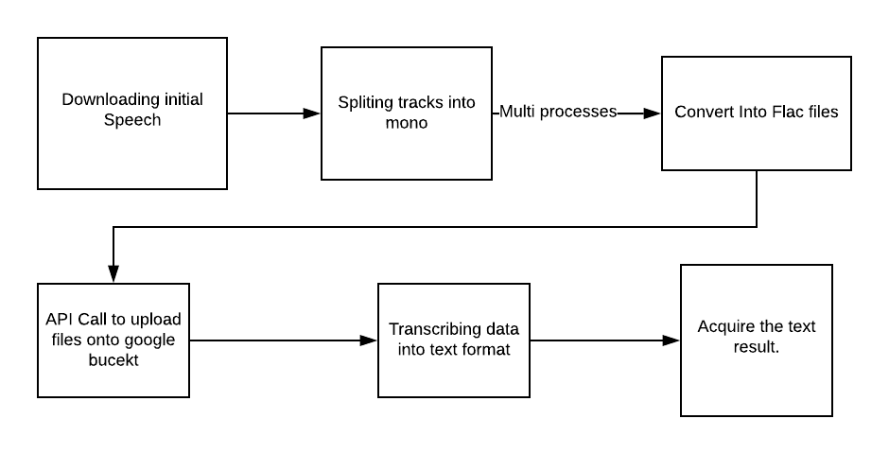
Acquiring Data Flow Chart

Slide 7
Acquiring Audio Files
Utilized Apple iTunes API to download a list of names of the top 200 podcasts.
Scrape the audio files from the PodBay.fm.

Slide 8
Audio File Formatting
Program splits the stereo files into flac files, so the Google Speech to Text API can utilize our data.

Slide 9
Google API
Each members of the project provided his or her free credit Google bucket accounts to transcribe the audio files.

Slide 10
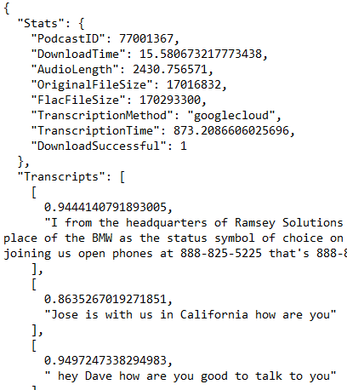
T3. Data
For each podcast, we acquired the following attributes:
PodcastID
Download Time
Audio Length
File Size
Transcription Time
Transcripts and their associated Confidence Score

Slide 11
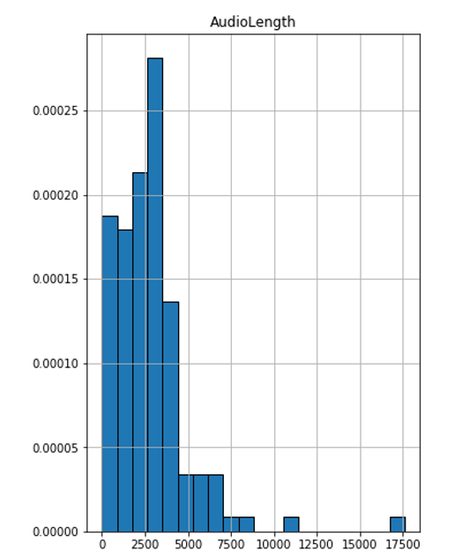
Data
Audio
The mean audio length for an individual podcast in a sample of 133 podcasts was 2757.25 seconds, or roughly 46 minutes.
Carries significance since we can use this data to project how much each "round" of collecting transcripts will cost us when using Google Speech to Text.

Slide 12
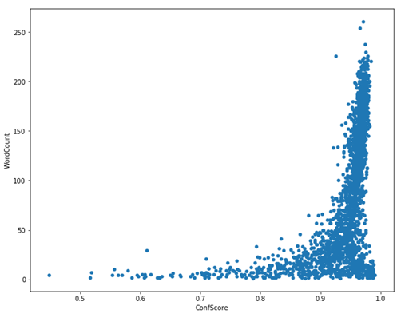
Data
Confidence Score
Google Speech to Text API generally reported a higher confidence score for transcript segments of a higher word count.
There were "only" 326 segments with a score less than 0.90 of 2228 segments (14.63%)

Slide 13
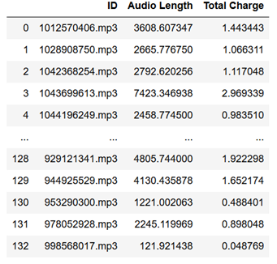
Data
Cost for the audio length.
The cost and audio length has a linear relation.

Slide 14
Research Objectives
Utilize topic modeling to give us a more rounded idea of the content of the podcast based on speech to text transcript data.

Slide 15
Harini
Questions Posed
Which topic modelling method to choose?
How to apply the model on the data for topic modelling?
How to determine similarity between the podcasts using the topic modelling method?

Slide 16
Harini
Tasks Performed
To acquire the data :- In this task utilized the Google speech to Text API to obtain the podcasts transcriptions.
Data Analysis:- This task includes the preprocessing ,basic statistics analysis, followed by finding a distribution to fit the data. Testing Hypothesis
Topic Model :- This task was time consuming , Latent Semantic Analysis was used here.
Analysing the results :-Topic Similarity Matrix was formed from the results of Topic Modelling.

Slide 17
Harini
Methods Used
LSA uses bag of word model, which results in a term-document matrix(occurrence of terms in a document).
TF gives the frequency of the words in each document in the corpus.
IDF is used to calculate the weight of rare words across all documents in the corpus.The words that occur rarely in the corpus have a high IDF score.
SVD is used to reduce the dimensions of the doc term matrix.To determine the number of topics , we use the topic coherence measure.

Slide 18
Harini
Progress Made on my Tasks
Preprocessing of data included removing of stopwords, numericals,and other symbols.
I was able to fit in the poisson’s distribution to the data.
LSA model was applied to 160 topics were obtained.
Similarity between the podcasts was calculated from the results of LSA model.

Slide 19
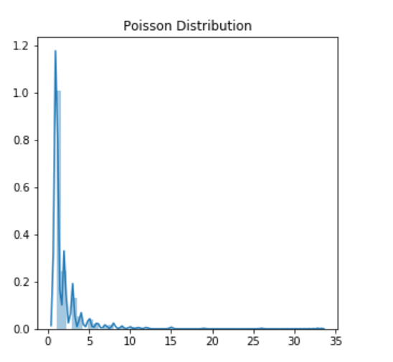
Harini:
Results
Poisson distribution applied.Frequency of words and Number of words is discrete
Observation, words with highest frequency are common
Across all the podcasts, where as words towards the end of
The distribution are unique and give more information on
The topic. This leads us to the Tf-IDF score which is the
Core logic of LSA.

Slide 20
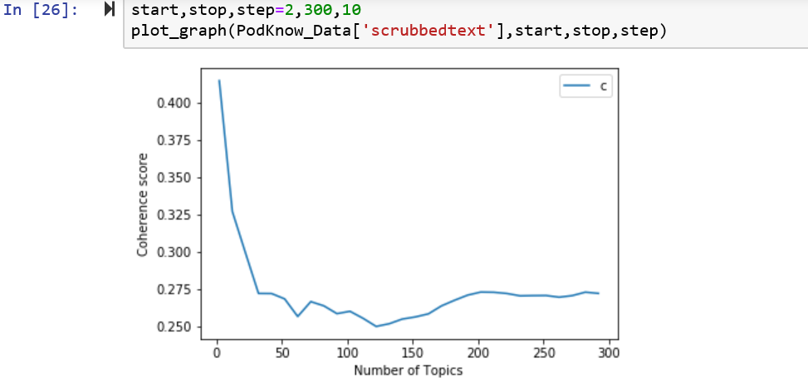
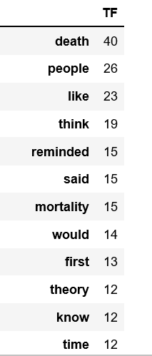
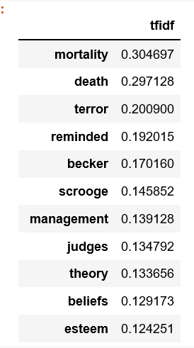
Harini
Results of LSA

Slide 21
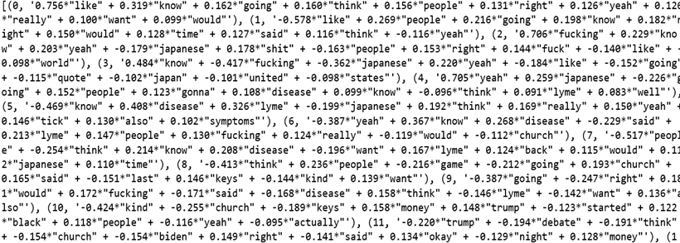
Glimpse of the Results

Slide 22
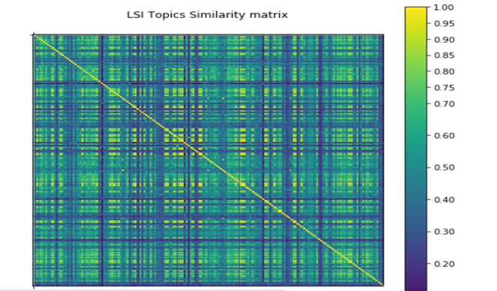
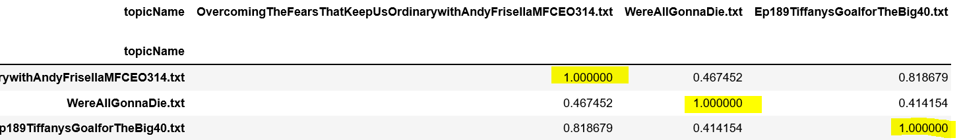
Harini
Documents similarity using LSA

Slide 23
Christopher
Statistics / Machine Learning Methods
Statistics:
Statistics data as it relates to Title vs. Content of the Podcast was collected using a Pandas dataframe for 151 podcasts from the set.
Pandas dataframes offered us the most accurate and easy to use interface for collecting the data.
Machine Learning:
LDA Models were created using SciKit for both bigrams as well as single words.
LDA Models were chosen due to the great visualization features that are available for them. Applying these models to our text data for a single podcast was returning good results.
A stretch goal for these models would be to implement categorization of topics directly into the model notebook.

Slide 24
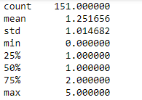
Christopher
Title vs Podcast Content Basic Statistics
Checking to see if the words from the title of the podcast appear within the podcast content.
How relevant is the title to the podcast?

Slide 25
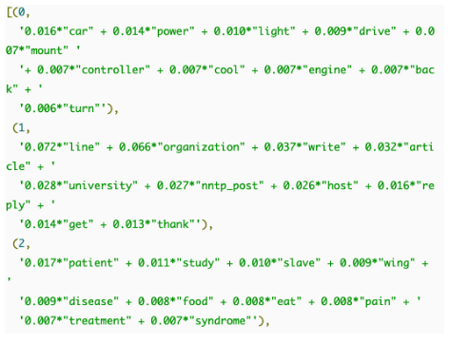
Christopher
Goals of LDA
The overall goal of topic modeling is to find which topics are most prevalent in the podcast so we can get a better idea of the content.
For the case of words, we would like to know which words are most important to a specific topic and what those topics are.

Slide 26
Christopher
LDA Dataflow
Multiple LDA models were created in order to find the optimal number of topics per podcast.
LDA is originally an unsupervised learning algorithm. However, if we were to implement Labeled LDA for categorization this would become a supervised learning model.

Slide 27
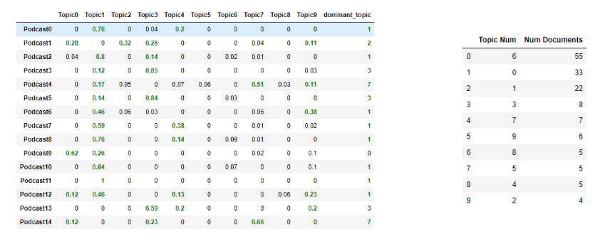
Christopher
Outcomes/Results (Most Dominant Topic / Most Relevant Topic)

Slide 28
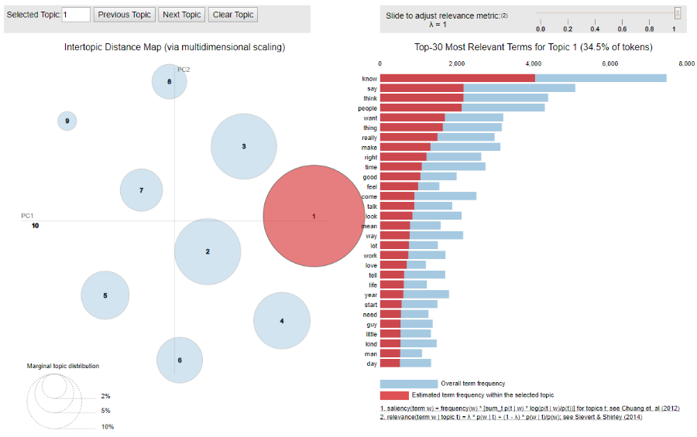
Christopher
LDA pyLDAvis Graph

Slide 29
Jeremy
T 2.1 - Describe the questions posed
What is the best way to convert audio to text for later analysis?
How can we measure similarity between topics using Gensim LDA models?
How do Gensim LDA models built from bigrams compare to models built using the entire document?
How do Gensim LDA models compare to SciKit LDA models?

Slide 30
Jeremy
T4 - Methodology
Experimented with different speech to text engines (PocketSphinx and Google Speech to Text)
Topic modeling using Gensim LDA models
Determined Hellinger distance
Built Gensim LDA models from bigrams generated from the NLTK
Performed statistical analysis using results from bigrams

Slide 31
Jeremy
T4 - Describe why the methods were chosen
Decided to use Google over Sphinx for accuracy
Used Gensim LDA models to compare results to SciKit and LSA
Determined Hellinger distance using built-in Gensim module to find topic similarity between podcasts
Implemented NLTK data into Gensim LDA models because the graph was outputting only a single topic using tokenized Gensim words

Slide 32
Jeremy
T4 - Describe why the method was chosen
Generated Gensim LDA models using NLTK bigram data to compare topics generated by single words vs. topics generated by bigrams for a given podcast

Slide 33

Jeremy
T4 - Progress Made on my Tasks
Successfully implemented a simple version of the Google Speech to Text API that returned a plaintext output, which my teammates improved upon
Used Hellinger distance to calculate the similarity between topics in Gensim LDA models using saved models and corpuses
Unrelated Podcasts:
True Crime Podcasts:

Slide 34
Jeremy
T4 - Progress Made on my Tasks
Determined that Gensim LDA models built from bigrams provide a different perspective on topics than the entire corpus does
Determined that Gensim LDA models have greater tendency to group topics than SciKit models
Analyzed statistics to determine topic discussion frequency using bigrams

Slide 35
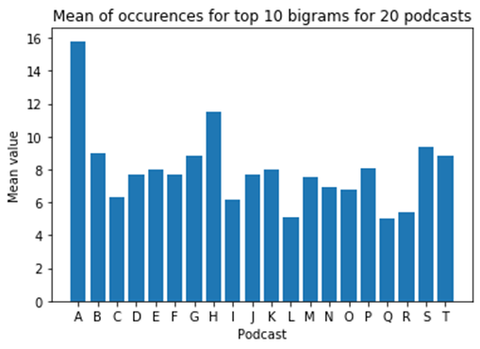
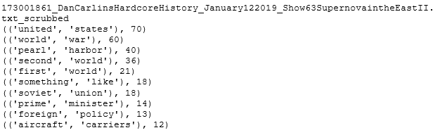
Jeremy
T5 - Basic Statistics and Insights
Acquired top 10 bigrams and calculated the mean of the occurrences of the top 10 bigrams per podcast to analyze topic discussion frequency / density
Variance of 5.8318
Low value: 5
High value: 15.8
Mean of all means taken is is 7.98

Slide 36
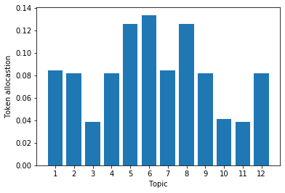
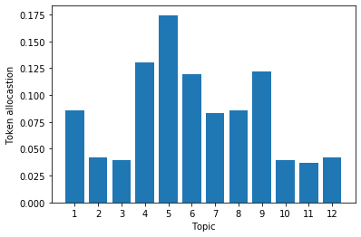
Jeremy
T5 - Advanced Statistics - Distribution Analysis and Insights
Determined that many bigram models produce roughly hypergeometric or binomial distributions because the model places primary confidence in a few topics and lower confidence in others
Wait wait… Don’t Tell me! The Ben Shapiro Show

Slide 37
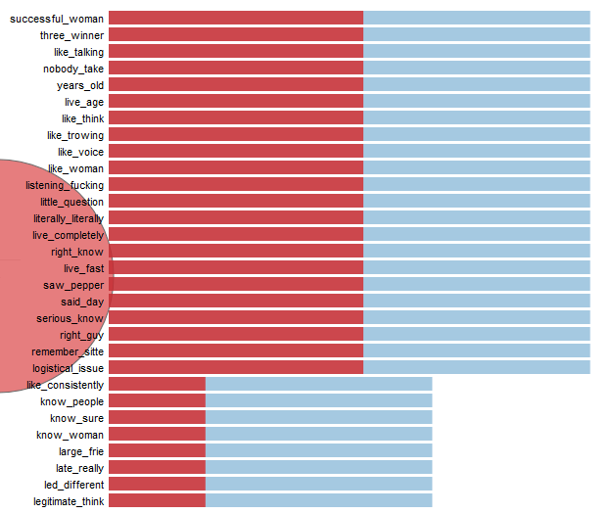
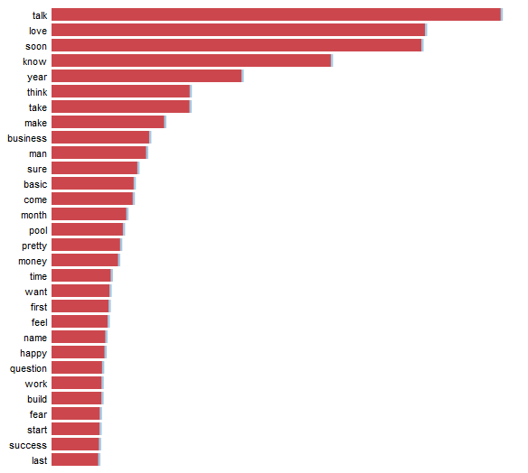
Jeremy
T5 - Machine learning / Dashboard results / demo

Slide 38


Jeremy
T5 - Machine learning / Dashboard results / demo

Slide 39
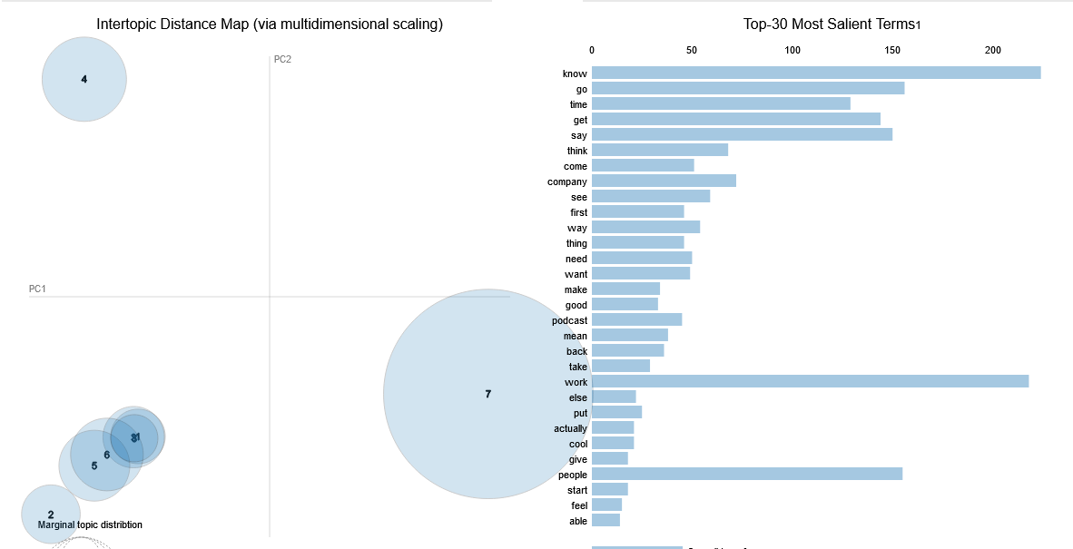
Jeremy
T5 - Machine learning / Dashboard results / demo
Results of Gensim topic clumping

Slide 40
Conclusion
Successfully developed methods to convert audio to text
Researched different methods of topic modeling
Performed statistical analysis on various podcast data
Need to develop a method to generate larger topics from keywords

Slide 41
Questions?

